Slide 1
sudo
主讲：马永亮(马哥)
QQ群:169777636
客服QQ：2813150558, 1661815153
http://www.magedu.com
http://mageedu.blog.51cto.com

Slide 4
sudo
su的局限 二级权限分类 su redhat su - redhat - .bashrc .bash_profile
centos
root rm -rf /*
假设A管理员有添加用户的权限，可以执行useradd
假设B管理员可以执行重启机器的权限，可以执行reboot
该怎么办？
sudo

Slide 5
sudo是linux系统管理指令，是允许系统管理员让普通用户执行一些或者全部的root命令的一个工具，如halt，reboot，su等等。这样不仅减少了root用户的登陆 和管理时间，同样也提高了安全性。Sudo不是对shell的一个代替，它是面向每个命令的。

Slide 6
sudo
什么是sudo？
  Sudo是可以让某个用户不需要拥有管理员的账号密码，可以执行管理员的权限的。
  作为管理员可以指派某些用户可以执行某些特定命令，类似与suid

Slide 7
Sudo的特点
它的特性主要有这样几点：
§ Sudo能够限制用户只在某台主机上运行某些命令。
§ Sudo提供了丰富的日志，详细地记录了每个用户干了什么。它能够将日志传到中心主机或者日志服务器。
§ Sudo使用时间戳文件来执行类似的“检票”系统。当用户调用sudo并且输入它的密码时，用户获得了一张存活期为5分钟的票（这个值可以在编译的时候改变）。
§ Sudo的配置文件是sudoers文件，它允许系统管理员集中的管理用户的使用权限和使用的主机。它所存放的位置默认是在/etc/sudoers，属性为0440。

Slide 8
如何配置sudo
配置文件：/etc/sudoers （sudo的配置文件定义很严格权限为400）
语法 who which_host=(whom) command
编辑命令visudo

Slide 9
Sudo的配置选项
#第一部分：用户定义，将用户分为millert, mikef, dowdy分组
User_Alias MASTER = millert, mikef, dowdy %gamemaster USER1
#第二部分，将操作类型分类，以谁的身份来执行命令。
Runas_Alias OP = root, oracle
#第三部分，将主机分类。这些都是随便分得，目的是为了更好地管理。
Host_Alias SPARC = bigtime, eclipse, moet, anchor
Host_Alias CUNETS = 128.138.0.0/255.255.0.0
Host_Alias CSNETS = 128.138.243.1, 128.138.204.0/24, 128.138.242.0
Host_Alias SERVERS = master, mail, www, ns
#第四部分，定义命令和命令地路径。命令一定要使用绝对路径，避免其他目录的同名命令被执行，造成安全隐患 ,因此使用的时候也是使用绝对路径!
Cmnd_Alias DUMPS = /usr/bin/mt, /usr/sbin/dump, /usr/sbin/rdump,\
/usr/sbin/restore, /usr/sbin/rrestore
Cmnd_Alias KILL = /usr/bin/kill
Cmnd_Alias PRINTING = /usr/sbin/, ! /usr/sbin/useradd, /usr/bin/lprm
Man文档中详细介绍

Slide 10
# Uncomment to allow people in group wheel to run all commands
# %wheel ALL=(ALL) ALL
# Samples
# %users ALL=/sbin/mount /cdrom,/sbin/umount /cdrom
# %users localhost=/sbin/shutdown -h now
# Same thing without a password
# %wheel ALL=(ALL) NOPASSWD: ALL
%表示本地系统组

Slide 11
Sudo的参数
参数
  -V 显示版本编号
  -h 会显示版本编号及指令的使用方式说明
  -l 显示出自己（执行 sudo 的使用者）的权限
  -v 因为 sudo 在第一次执行时或是在 N 分钟内没有执行（N 预设为五）会问密码，这个参数是重新做一次确认，如果超过 N 分钟，也会问密码
  -k 将会强迫使用者在下一次执行 sudo 时问密码（不论有没有超过 N 分钟）
  -b 将要执行的指令放在后台执行

Slide 12
Sudo的参数
参数
  -p prompt 可以更改问密码的提示语，其中 %u 会代换为使用者的帐号名称， %h 会显示主机名称
  -u username/#uid 不加此参数，代表要以 root 的身份执行指令，而加了此参数，可以以 username 的身份执行指令（#uid 为该 username 的使用者号码）
  -s 执行环境变数中的 SHELL 所指定的 shell ，或是 /etc/passwd 里所指定的 shell
  -H 将环境变数中的 HOME （家目录）指定为要变更身份的使用者家目录（如不加 -u 参数就是系统管理者 root ）
  command 要以系统管理者身份（或以 -u 更改为其他人）执行的指令

Slide 13
tcp wrapper
主讲：马永亮(马哥)
QQ:113228115
客服QQ：1661815153
http://www.magedu.com
http://mageedu.blog.51cto.com

Slide 16
xinetd
主讲：马永亮(马哥)
QQ:113228115
客服QQ：1661815153
http://www.magedu.com
http://mageedu.blog.51cto.com

Slide 18
pam
主讲：马永亮(马哥)
QQ:113228115
客服QQ：1661815153
http://www.magedu.com
http://mageedu.blog.51cto.com

Slide 19
vsftpd
  nsswitch
    名称解析的框架
      libnss*
        /lib64
        /usr/lib64
  pam

Slide 20
nsswitch (名称解析)
  Network Service Switch
    username, UID
    group, GID
    http, 80
    FQDN , www.magedu.com, IP
HOSTNAME → IP
IP → HOSTNAME
  /var/named/
    数据库
username → UID
  /etc/passwd
  每一行，record

Slide 21
nsswitch
login, root→0
  /etc/passwd
  mysql → table
  ldap
  nis
glibc (libnss())
nginx → nginx.conf
  user www www;

Slide 22
nsswitch.conf
firefox
nis
  名称解析库
login
gethostname
libnss3.so
file
dns
libnss_files.so
/etc/passwd
nis server
/etc/hosts
libnss_dns
/etc/resolv.conf

Slide 23
login
  /etc/passwd
  nis
nis Client
nis Client
nis Client
nis Client
nis Client
nis Client
nis Client
nis Client
nis Client

Slide 24
PAM
  Pluggable Authentication Module
Authentication
  password: 口令
  username, password
login
  root
  password
    /etc/shadow
    mysql table
    ldap
    nis

Slide 25
httpd, 具有认证实现代码
  .htpasswd
  mysql table
  ldap
vsftpd
login
vsftpd
ssh
PAM
/etc/pam.conf
/etc/pam.d/
Kerberos
winbind
unix
ldap

Slide 26
PAM
vsftpd → PAM
PAM, /etc/pam.d/vsftpd

Slide 27
Authentication & Authorization
The process of determining whether a client shoud have access to a resource can be divided into to tasks
  Authentication determines whether a client username and password is authenticated
    For instance, a person logging in with a correct username and password is authenticated
  Authorization determines whether or not a user is granted access to a service
    Even if you correctly authenticate, you may be denied access due to other restrictions (service configuration, /etc/securetty, etc)

Slide 28
名称解析
A user
  username
  password
username → UID
groupname → GID
FQDN→IP
http→80
route

Slide 29
App → nsswitch → resolve_lib
  nsswitch
login
  username
/etc/nsswitch.conf
  passwd: file
  group: file
    root → UID
  hostname: file dns

Slide 30
Users and Groups
Every user account has a unique UID
Every group account has a unique GID
Every process has a persona
  A UID, primary GID, any supplementary GIDs
  SELinux identity:role:domain context
  Determines what resources the process is authorized to access

Slide 31
Standard C Library
Provides standard APIs for system functions
  GNU libc (glibc) is used by almost every program in the standard distribution
  Implements APIs in user space or as one or more kernel system calls
  It provides name services, to resolve hostnames to IP address and user names to UID numbers
  Memory handling, I/O, sockets, signals, process control, etc.
Processes get information about users and groups through C library functions
  Such as getpwent()

Slide 32
Simple Unix Authentication
User provides username and password
Application uses getpwnam() C library function to lookup stored information for the provided username
  /etc/passwd, username
  nsswitch.conf
Application hashes the provided password and compares it to the stored password hash
If the hashes match, the user is authenticated

Slide 33
C Library Name Services
getpwnam() and other C library functions use the libc name service to map a name to information
Originally, local files like /etc/passwd and /etc/hosts were the only name service
To add each new name service (DNS,NIS, and so on) originally required rewriting libc
  However, this model of rewriting part of libc every time a new name srvice became available was awkward
  Not only did name service changes require replacement of the C library, but search order and use of different name srvices tended to be inflexible

Slide 34
dns
  name → ID
  glibc c库（/etc/passwd)
  /etc/passwd
  username:x:uid

Slide 35
Name Service Switch
NSS allows new name services to be added as modules without rewriting libc
To support a new name service, install a new /lib/libnss_service.so file
The order in which name services are checked by library functions is controlled by /etc/nsswitch.conf

Slide 36
Name Service Switch
/etc/nsswitch.conf
nis
files
ldap

Slide 37
/etc/nsswitch.conf
First item on each line is a administrative database of names needed by libc
  aliases, ethers, group, hosts, netgroup, networks, passwd, protocols, rpm, services, shadow
Remainder of line is a list of name services to query which contain the relevant information
  Services are checked in the order listed
  passwd: files nis ldap

Slide 38
Name Service Lookup Results
Four results are possible when looking up an entry in a particular name service
  SUCCESS service ok, found name
  NOTFOUND service ok, name not found
  UNAVAIL service not available
  TRYAGAIN temporary service failure
By default, return on the first SUCCESS, otherwise continue

Slide 39
Result Actions
The action taken for a particular lookup result can be changed
  passwd: nis [NOTFOUND=return] files
In the example above, libc will try to look up passwd information in NIS, and will only use local files if NIS is not available
  This example would require the root account to be stored in NIS, which is not ideal

Slide 40
passwd: nis [NOTFOUND=return] files

Slide 41
new, nis, ldap, mysql, passwd
passwd: ldap files
ldap

Slide 42
db (Berkeley DB)
  key-value
dns
files
hesiod
ldap
nis
nisplus, nis+
winbind
wins

Slide 43
nsswitch
  功能：为应用程序提供名称解析转换功能的框架，同时也提供了多种不同解析模块
  组成：
    libnss, libnss_modules
  配置文件：/etc/nsswitch.conf
    administrative database: resolve_database
      返回值：SUCCESS, NOTFOUND, UNAVAIL, TRYAGAIN
      动作：return, continue
      格式： [返回值=动作]
  getent命令
    getent admin_database
    getent admin_database record

Slide 44
getent
getent database
  List all objects stored in the specified C library administrative database
  getent services
getent database name
  Look up the information stored in the specified database for a particular name
  # getent passwd wendy

Slide 45
App → username: password
  root → nsswitch.conf → passwd: files
  ‘123456’ → nsswitch.conf → shadow: files
  auth: 123456 → md5(salt) → compare
    认证本身也可以不用借助名称解析服务去查找用户原来存放的密码

Slide 46
Authentication
  md5: /etc/shadow pam_unix.so
  mysql
  ldap
  nis
  Kerberos
App: login, /etc/pam.d/login
APP → PAM →Authentication
Framework
libraries

Slide 47
Other Authentication Methods
There are other ways to authenticate users by password than the standard UNIX method
  Initial kerberos authentication
  Windows NT domain authentication
  and so on
Originally, applications had to be rewritten to change how they authentication users
  Every application had to be handled sepatately

Slide 48
/etc/shadow
  /etc/shadow
  mysql
  ldap
  kerborose
  nis
PAM
  Pluggable Authentication Module

Slide 49
Authentication
vsftpd
login
su
PAM
ldap
unix
krb5

Slide 50
vsftpd
nsswitch
PAM
PAM
conf

Slide 51
PAM
Pluggable Authentication Modules
  A generic framework for applications which must handle authentication and authorized of users
Centralized, shared code base
  A PAM-enabled application calls the PAM libraries to perform all authencation tasks for it and return a pass or fail response to the applicaton
Dynamically configurable
  Install a new module to add new authentication methods or other capabilities
  Edit application’s PAM configuration, changes take effect immediately

Slide 52
PAM Authentication
Application (pam-aware) calls PAM library functions to authenticate users
  Application provides a “conversation function” so PAM can prompt the user for input
PAM library handles authentication checks based on the application’s PAM configuration
  The PAM library looks at its configuration files and determines which modules need to be executed
  May include standard UNIX authentication
PAM returns success or failure to the calling application

Slide 53
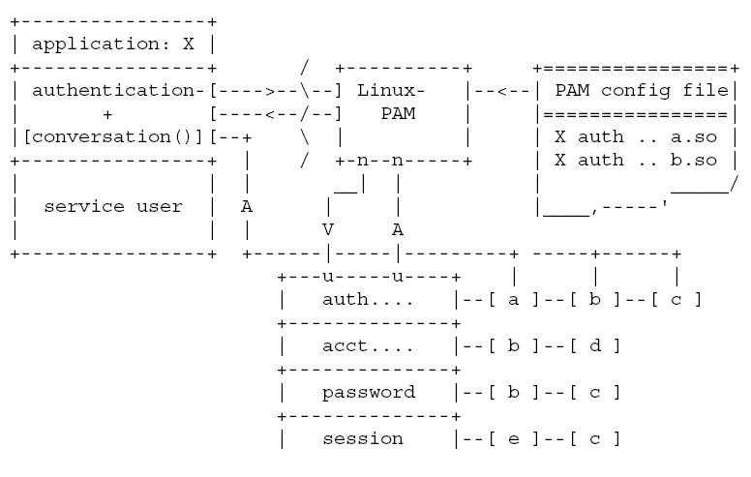

Slide 54
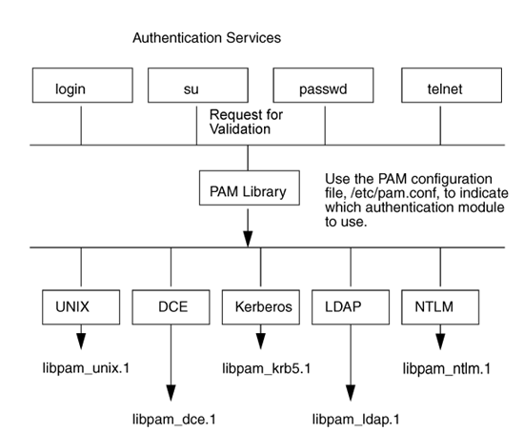

Slide 55
PAM Configuration
/lib/security/ contains PAM modules
  /etc/security/ contains supplementary configuration files for some PAM modules
/etc/pam.d/ contains configuration files for the application that use PAM
  Determines which modules are used by which applications, in what order
  Configuration files used normally has the same name as the service using PAM

Slide 56
NSS & PAM
  NSS
    Name Service Switch
passwd: files
/lib/libnss_
/usr/lib/
nis

Slide 57
  PAM
    Authentication
login
PAM
/lib/security/
/etc/pam.conf
/etc/pam.d/

Slide 58
PAM
  /etc/pam.conf
    Service type control module-path module-arguments
  /etc/pam.d/service
    type control module-path [module-arguments]

Slide 59
Configuration file syntax
The file is made up of a list of rules, each rule is typically placed on a single line, but may be extended with an escaped end of line
  Service type control module-path module-arguments
Directory based configuration
  The syntax of each file in /etc/pam.d/ is similar to that of the /etc/pam.conf file and is made up of lines of the following form:
  type control module-path module-arguments

Slide 60
The service
service
  The service is the name of the file in the /etc/pam.d/ directory
  This filename must be in lower case
An important feature of PAM, is that a number of rules may be stacked to combine the services of a number of PAMs for a given authentication task
The service is typically the familiar name of the corresponding application
The service-name, other, is reserved for giving default rules
Only lines that mention the current service (or in the absence of such, the other entries) will be associated with the given service-application

Slide 61
The type
The management group that the rule corresponds to
Used to specify which of the management groups the subsequent module is to be associated with

Slide 62
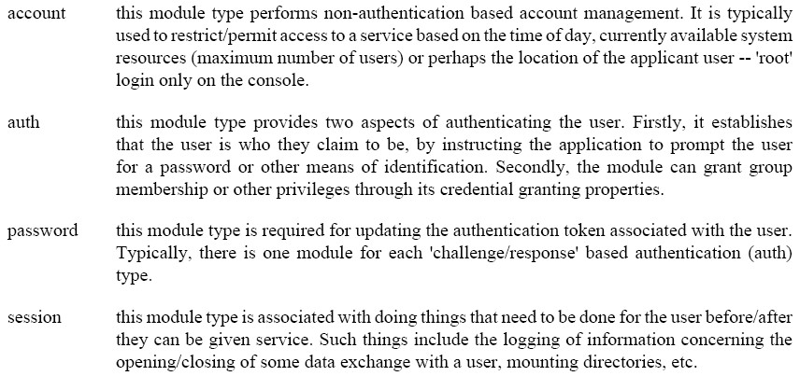
Each of these groups is independent
A module need not support all four groups

Slide 63
The control
Indicates the behavior of the PAM-API should the module fail to succeed in its authentication task
There are two types of syntax for this control field:
  the simple one has a single simple keyword
  the more complicated one involves a square-bracketed selection of value=action pairs

Slide 64
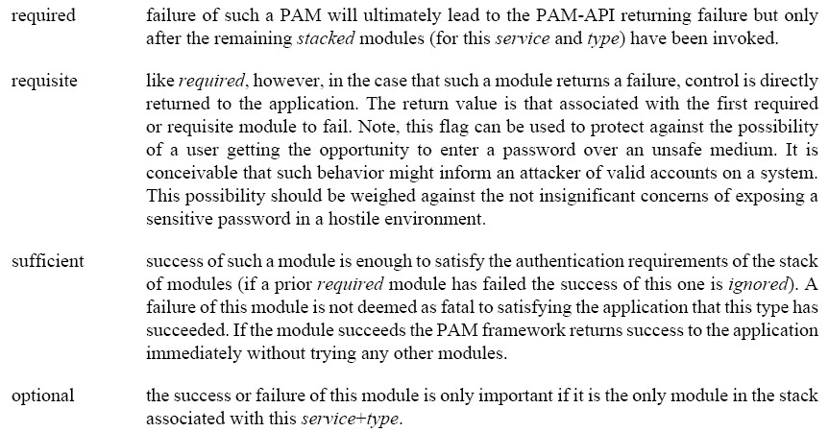

Slide 65
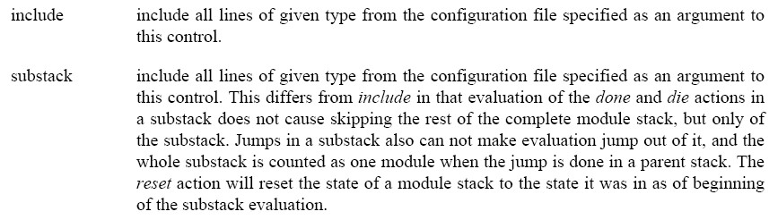

Slide 66
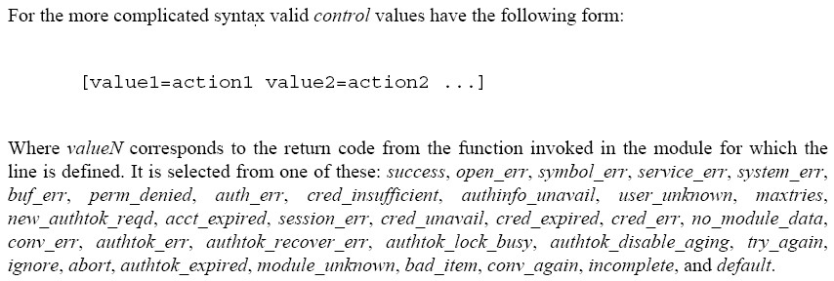

Slide 67
More advanced syntax for controlling how PAM reacts to different module return codes
  Can fine tune authentication based on the reason why the modules failed
Assigns a action to particular return codes
  About thirty different return codes, as described in previous page
Six standard actions
  ok, done, bad, die, ignore, reset

Slide 68
ok This modules passed, keep checking
done This modules passed, and return the final result to the application now
bad The result is failed, keep checking
die The result is failed, and return the failure result to the application now
ignore The result will not affect the overall result
reset Ignore any results that have already been collected in the final result

Slide 69
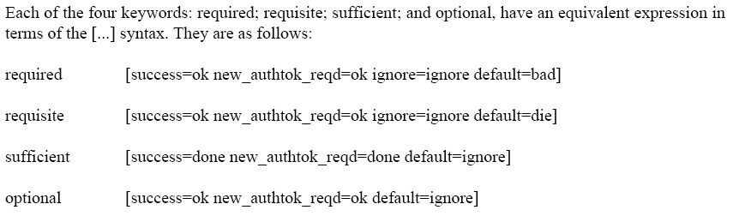

Slide 70
module-path is either the full filename of the PAM to be used by the application (it begins with a '/'), or a relative pathname from the default module location: /lib/security/ or /lib64/security/, depending on the architecture
module-arguments are a space separated list of tokens that can be used to modify the specific behavior of the given PAM.
  Such arguments will be documented for each individual module
  Note, if you wish to include spaces in an argument, you should surround that argument with square brackets

Slide 71
Basic PAM Modules
pam_unix - traditional password authentication
  This module implements standard C library name service checking as a modular check
  Therefore, instead of calling the getpwent() calls directly, the application calls PAM and has it perform those checks through C library calls in the pam_unix module
OPTIONS
  nullok
  shadow Try to maintain a shadow based system.
  md5 When a user changes their password next, encrypt it with the MD5 algorithm.

Slide 72
Basic PAM Modules
pam_permit
  A PAM module that always permit access. It does nothing else
pam_deny
  This module can be used to deny access
  It always indicates a failure to the application through the PAM framework
  It might be suitable for using for default (the OTHER) entries

Slide 73
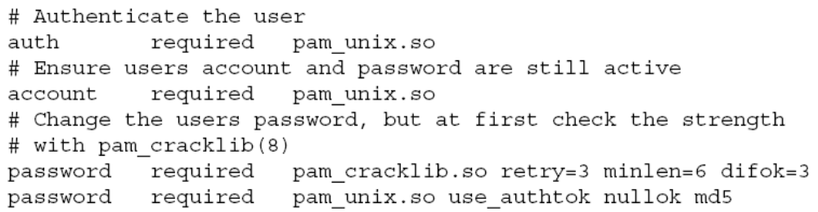
EXAMPLES

Slide 74
include Control Value
The include control value includes all the the checks for this management group from another PAM services configuration file at this point in the file
The checks from the other file are each performed as if they were inserted into this file individually at that point
  auth required pam_securetty.so
  auth include system-auth
  auth required pam_env.so
  auth sufficent pam_unix.so nullok
  auth required pam_deny.so

Slide 75
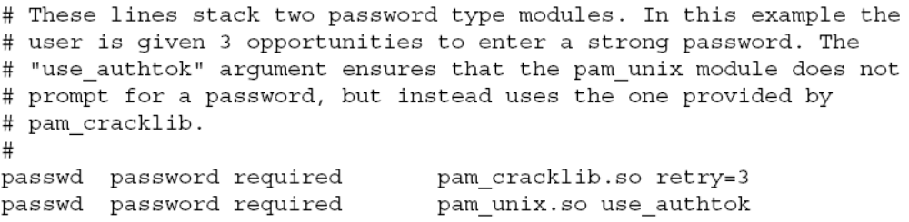
pam_cracklib.so
checks the password against dictionary words
  Prompts for the new password
  Checks password against rules and a database
  Passes password to the next stacked module
  Options, such as
    minlen, difok, dcredit=N, ucredit=N, lcredit=N, ocredit=N, retry=N

Slide 76
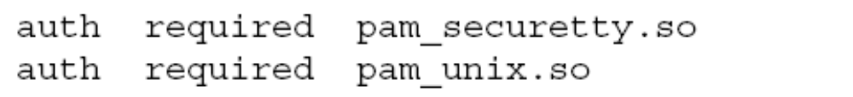
pam_shells
  check for valid login shell
  A PAM module that only allows access to the system if the users shell is listed in /etc/shells.
pam_securetty
  Limits root login to special devices
  A PAM module that allows root logins only if the user is logging in on a "secure" tty, as defined by the listing in /etc/securetty
  Also checks to make sure that /etc/securetty is a plain file and not world writable

Slide 77
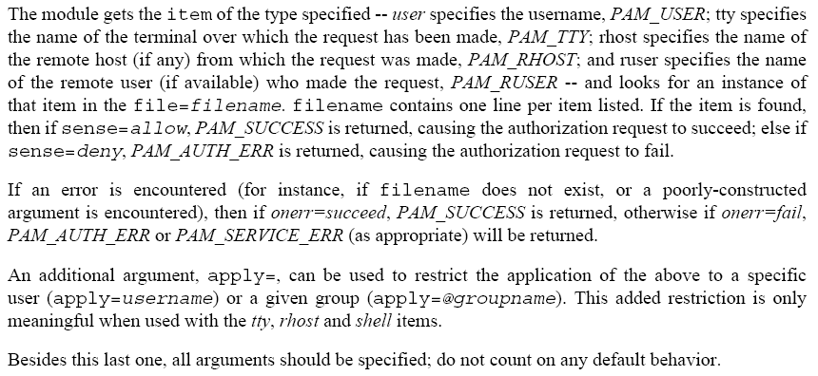
pam_listfile
  A PAM module which provides a way to deny or allow services based on an arbitrary file

Slide 78
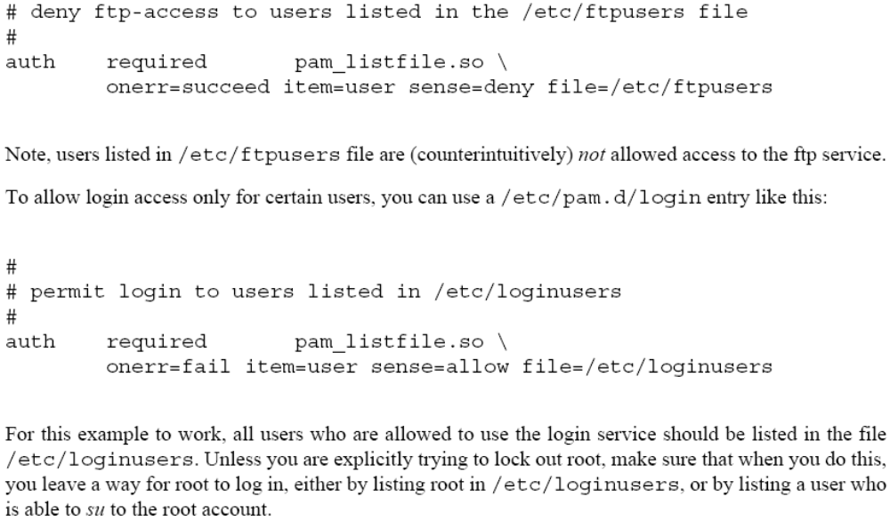
EXAMPLES

Slide 79
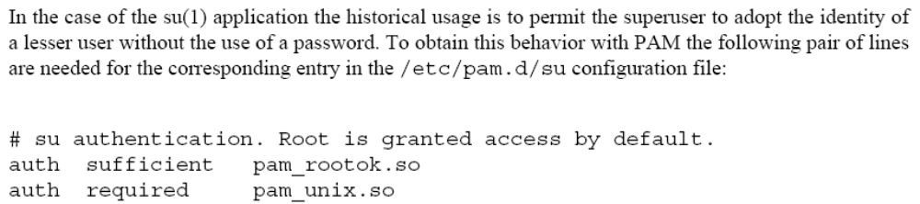
pam_rootok
  A PAM module that authenticates the user if their UID is 0
  Applications that are created setuid-root generally retain the UID of the user but run with the authority of an enhanced effective-UID

Slide 80
pam_limits
The pam_limits PAM module sets limits on the system resources that can be obtained in a user-session.
Users of uid=0 are affected by this limits, too.
By default limits are taken from the /etc/security/limits.conf config file.
Then individual *.conf files from the /etc/security/limits.d/ directory are read.

Slide 81
DESCRIPTION
  syntax
    <domain> <type> <item> <value>
  <domain>
    a username
    a groupname, with @group syntax
    the wildcard *, for default entry
  <type>
    hard for enforcing hard resource limits.
    soft for enforcing soft resource limits
    - for enforcing both soft and hard resource limits together

Slide 82
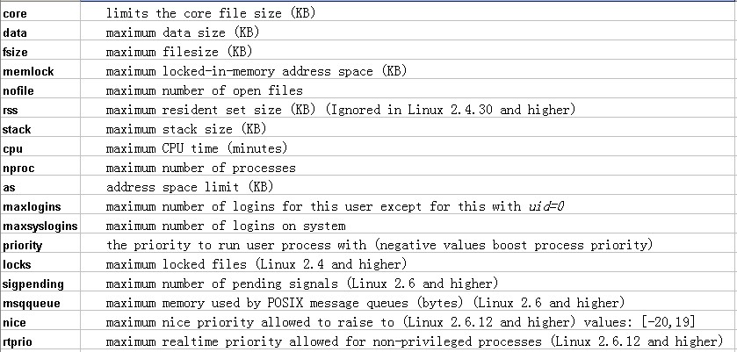
  <item>
    All items support the values -1, unlimited or infinity indicating no limit, except for priority and nice.

Slide 83
  EXAMPLES
    * soft core 0
    * hard rss 10000
    @student hard nproc 20
    @faculty soft nproc 20
    @faculty hard nproc 50
    ftp hard nproc 0
    @student - maxlogins 4

Slide 84
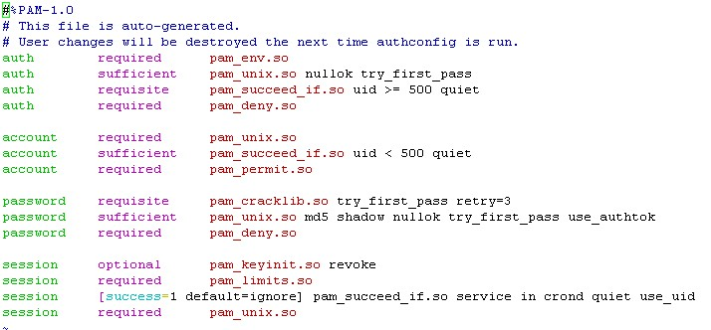
system-auth

Slide 85
awk
主讲：马永亮(马哥)
QQ:113228115
客服QQ：1661815153
http://www.magedu.com
http://mageedu.blog.51cto.com

Slide 86
数字索引：数组
字串索引：关联数组

Slide 88

关于马哥教育
博客：http://mageedu.blog.51cto.com
主页：http://www.magedu.com
QQ：1661815153, 113228115
QQ群：203585050, 279599283

Slide 89
Thank You!

